Slide 1

IST 597: Foundations of Data Privacy k-anonymity, l-diversity, t-closeness: promises and perils
February 14, 2022
Partial slide credit: Anna Squicciarini (PSU), Joe Near (UVM), Murat Kantarcioglu (UT Dallas), Jeremiah Blocki (CMU)

Slide 2
Logistics,
Groups, etc.
https://docs.google.com/document/d/1TYMT4HfcAcw4HR930UufaWkSO7xEWlQtc-32ma00ZVY/edit
Homework 2: released today; due February 28
Reach out to myself and/or Jinquan with questions/concers.

Slide 3
Class Outline
k-anonymity
l-diversity
t-closeness
Break & post to discussion (20 minutes)
Presentation – Usable privacy (30 minutes)
Hands-on coding

Slide 4
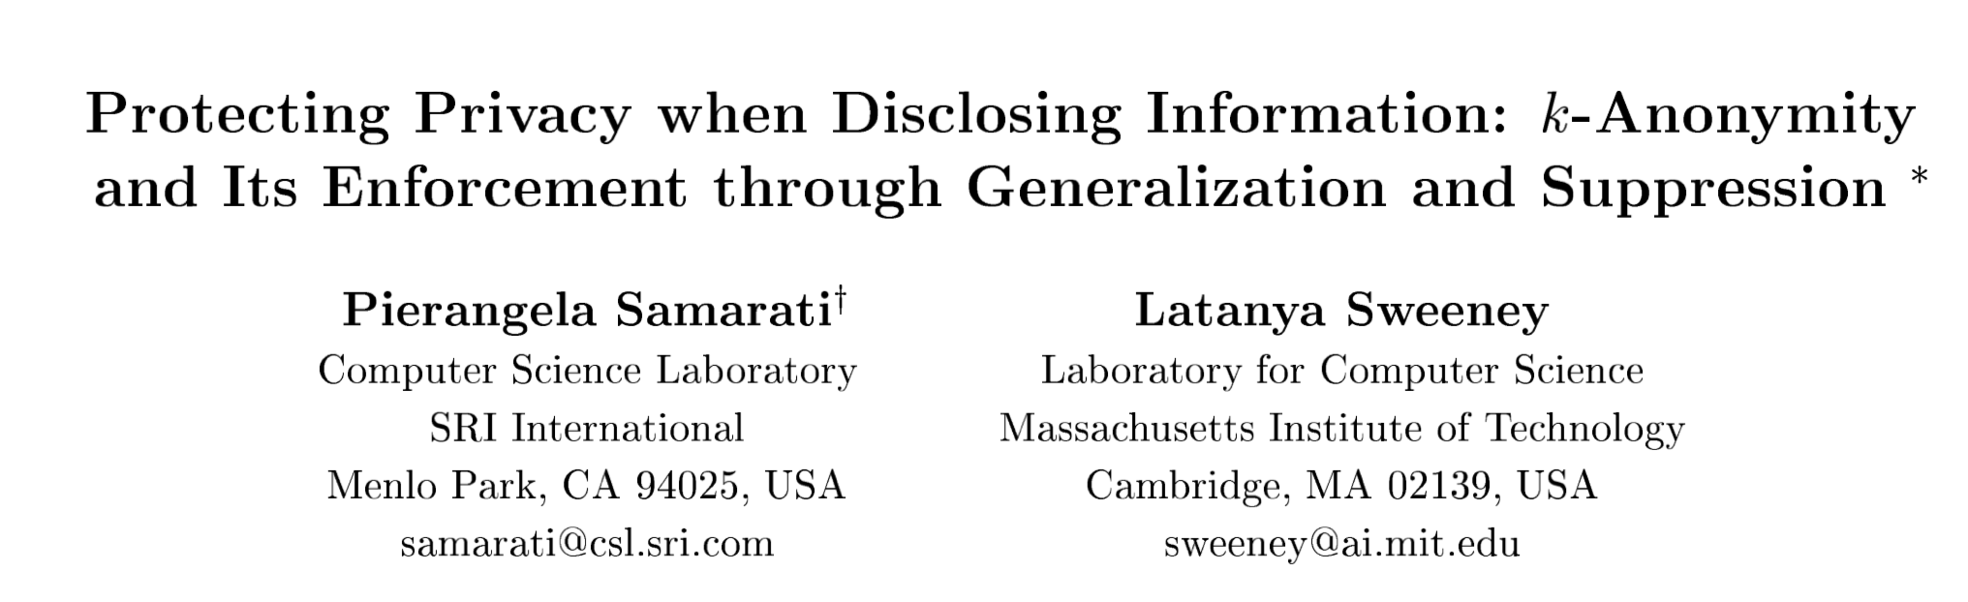

Slide 5
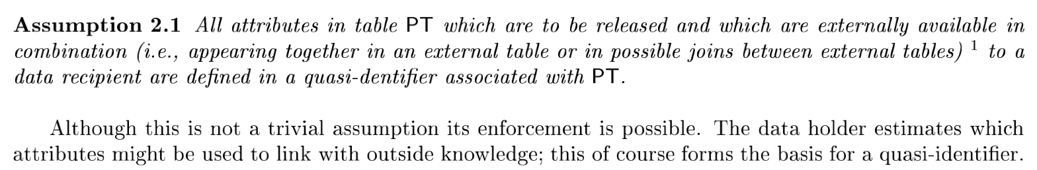
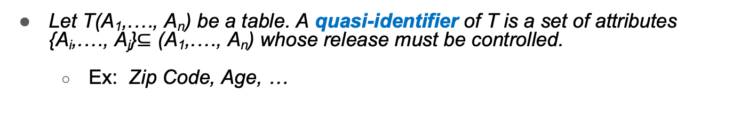
Attribute Classification
Explicit identifier attributes
Information that leads to a specific entity. Suppress right away.
Let T(A₁,.…, A_{n}) be a table. A quasi-identifier of T is a set of attributes {A_{i},.…, A_{j}}$⊆$ (A₁,.…, A_{n}) whose release must be controlled.
Ex: Zip Code, Age, …
k-anonymity requirement Each release of data must be such that every combination of values of quasi-identifiers can be indistinctly matched to at least k individuals.

Slide 6
Attribute Types
Identifier, Key (Quasi-Identifiers) and Confidential Attributes
RecID | Name | SSN | Age | State | Diagnosis | Income | Billing
1 | John Wayne | 123456789 | 44 | MI | AIDS | 45,500 | 1,200
2 | Mary Gore | 323232323 | 44 | MI | Asthma | 37,900 | 2,500
3 | John Banks | 232345656 | 55 | MI | AIDS | 67,000 | 3,000
4 | Jesse Casey | 333333333 | 44 | MI | Asthma | 21,000 | 1,000
5 | Jack Stone | 444444444 | 55 | MI | Asthma | 90,000 | 900
6 | Mike Kopi | 666666666 | 45 | MI | Diabetes | 48,000 | 750
7 | Angela Simms | 777777777 | 25 | IN | Diabetes | 49,000 | 1,200
8 | Nike Wood | 888888888 | 35 | MI | AIDS | 66,000 | 2,200
9 | Mikhail Aaron | 999999999 | 55 | MI | AIDS | 69,000 | 4,200
10 | Sam Pall | 100000000 | 45 | MI | Tuberculosis | 34,000 | 3,100

Slide 7
Check for k-Anonymity
RecID | Age | Zip | Sex | Illness
1 | 50 | 41076 | Male | AIDS
2 | 30 | 41076 | Female | Asthma
3 | 30 | 41076 | Female | AIDS
4 | 20 | 41076 | Male | Asthma
5 | 20 | 41076 | Male | Asthma
6 | 50 | 41076 | Male | Diabetes
QID = { Age, Zip, Sex }
SELECT COUNT(*) FROM Patient GROUP BY Sex, Zip, Age;
If the results include groups with count less than k, the relation Patient does not have k-anonymity property with respect to QID.

Slide 8
How to achieve it?

Slide 9
How to achieve (useful) anonymization
Objective:
Analytical Utility of QI must be preserved
Correlation of QI and and sensitive data must be maintained.

Slide 10
Achieving k-Anonymity
Generalization
Replace specific quasi-identifiers with more general values
Example: area code instead of phone number
Partition ordered-value domains into intervals
Suppression
When generalization causes too much information loss
This is common with “outliers” (come back to this later)
Lots of algorithms in the literature
Aim to produce “useful” anonymizations
… usually without any clear notion of utility
*Implies the existence, for each domain D, of a hierarchy.
We call this the domain generalization hierarchy (DGH_{D})

Slide 11
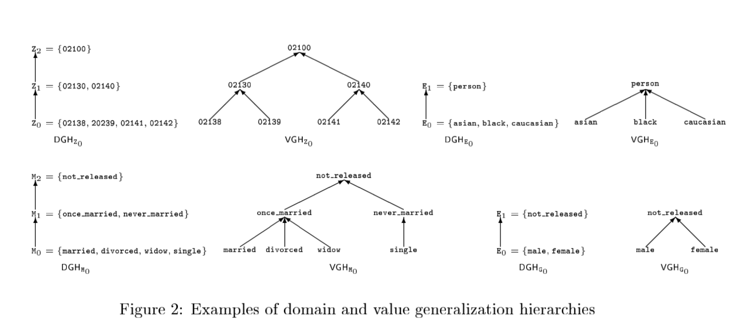
Generalization in Action
*A value generalization relationship is a partial order $≤_{V}$ which associates with each value $v_{i}$ in domain D_{i} a unique value in domain D_{j}, a direct generalization of D_{i}.
This order implied the existence of a value generalization hierarchy (VGH_{D})

Slide 12
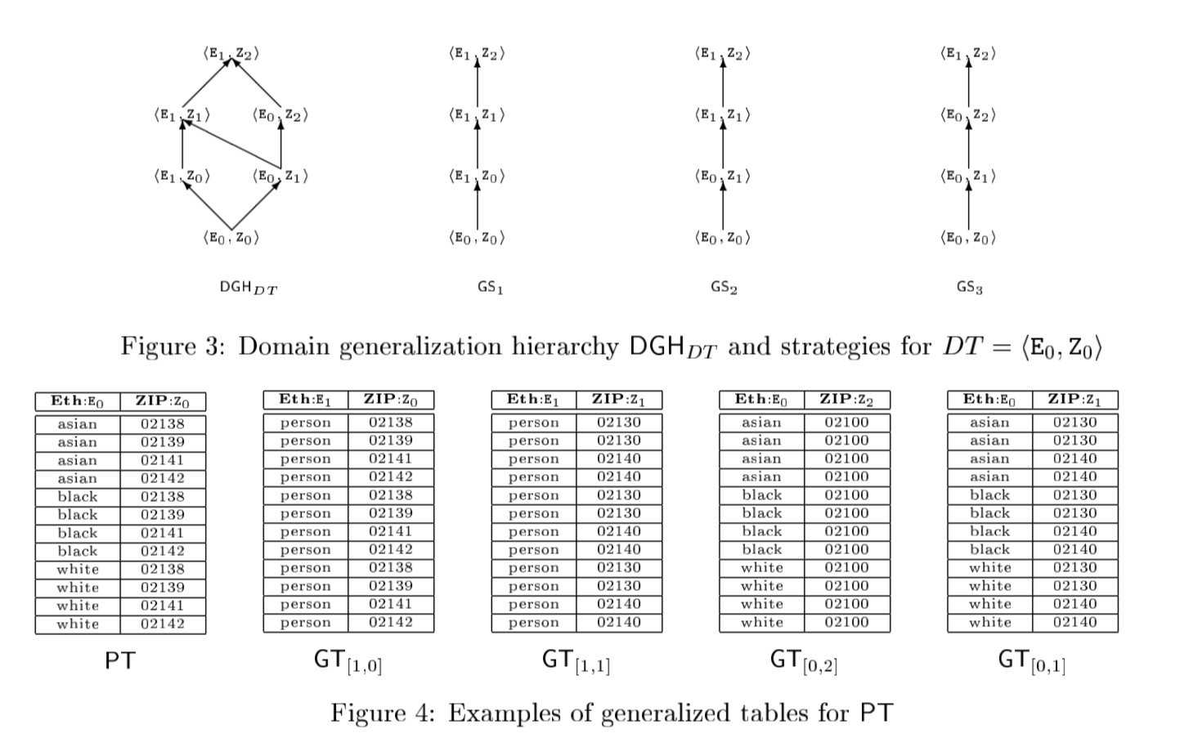
Generalization in Action

Slide 13
k-minimal Generalization
Given # of records ≥ k, there is always a trivial solution!
→ Generalize all attributes to VGH root
– Not very useful if there exists another k-anonymization with higher granularity (more specific) values
• k-minimal generalization
+Satisfies k-anonymity
+None of its specializations satisfies k-anonymity
– E.g., [0,2] is not minimal, since [0,1] is k-anonymous
– E.g., [1,0] is minimal, since [0,0] is not k-anonymous
What are the potential limitations with this approach?

Slide 14
Taxonomy of generalization algorithms
Top-down specialization vs. bottom-up generalization
Global (single dimensional) vs. local (multi-dimensional)
Global: E.g., partition an attribute into intervals; replace attribute by more general ones from some hierarchy
Local: delete individual attribute values; e.g., <50,Male,California>
Complete (optimal) vs. greedy (approximate)
Hierarchy-based (user-defined) vs partitioned based (automatic)
Le Ferve, DeWitt, Ramakrishnan. Incognito: Efficient Full-Domain K-Anonymity. In SIGMOD ‘05.

Slide 15
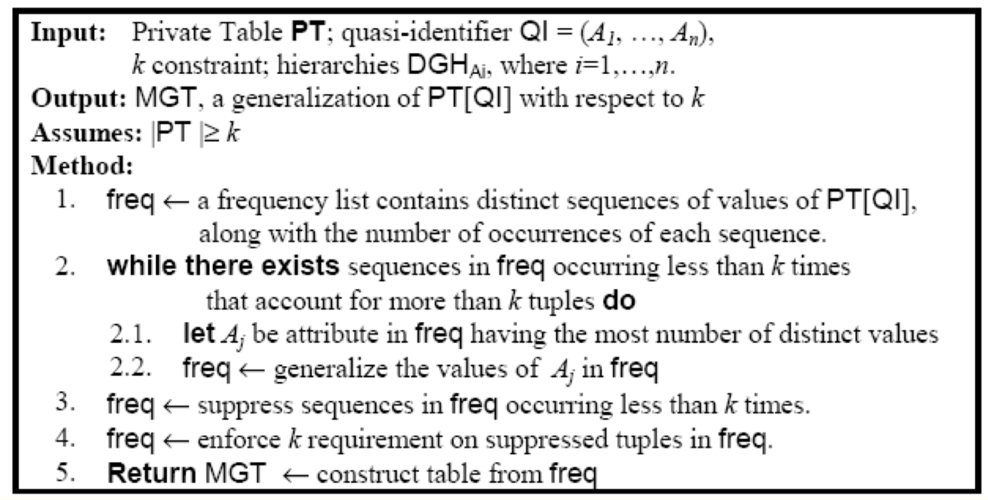
DataFly Algorithm
Greedy
Global generalization with tuple suppression
Sweeney, 1997
Create equivalences over the Cartesian product of QI attributes
Heuristically select an attribute to generalize
Continue until < k records remain (suppression)

Slide 16
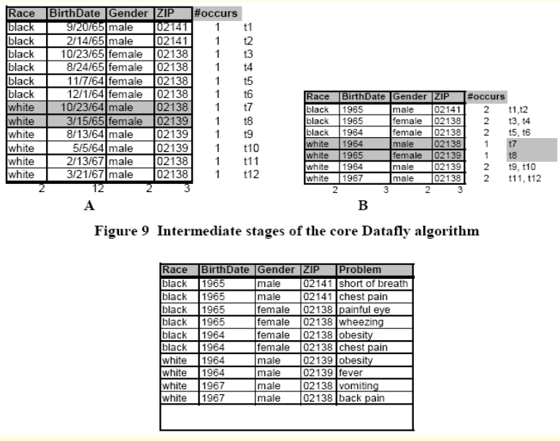
Datafly in Action
K-anonymity is guaranteed
Lots of distortion due to global changes to the data.
K=2
QI: race, gender, Birthdate, Zip
Notes:
Generalizing all values associated with an attribute (global) 2. Suppressing all values within a tuple (global) 3. Selecting the attribute with the greatest number of distinct values as the one to generalize first – computationally efficient but may over generalize

Slide 17
A list of possible algorithms
µ-Argus, Hundpool, 1996 - Global, bottom-up, greedy
Datafly, Sweeney, 1997 - Global, bottom-up, greedy
AllMin, Samarati, 2001 - Global, bottom-up, complete, impractical
MinGen, Sweeney, 2002 - Global, bottom-up, complete, impractical
Wang, 2004 – Global, bottom-up, greedy
TDS (Top-Down Specialization) Fung, 2005 - Global, top-down, greedy
K-OPTIMIZE, Bayardo, 2005 – Global, top-down, partition-based, complete
Incognito, LeFevre, 2005 – Global, bottom-up, hierarchy-based, complete
Mondrian, LeFevre, 2006 – Local, top-down, partition-based, greedy

Slide 18
MinGen Algorithm
Generate all generalizations of the private table
Discard those that violate k-anonymity
Find all generalizations with the highest precision
Return one based on some preference criteria
Unrealistic!
Even with attribute-level generalization and suppression, there are too many candidates

Slide 19
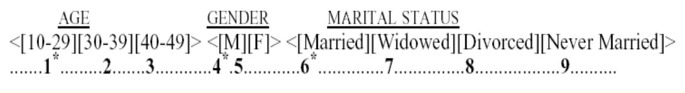
Modeling anonymizations
Assume a total order over the set of all attribute domains
Set representation for anonymization
E.g., age <[10-29],[30-49]>, gender: <[M or F]>, Martial status: <[Married],[Widowed or Divorced],[Never Married]>
{1,2,4,6,7,9} → {2,7,9}
Power set representation for entire anonymization space
Power set of {2,3,5,7,8,9} - order of 2^n!
{} – most general anonymization
{2,3,5,7,8,9} – most specific anonymization

Slide 20
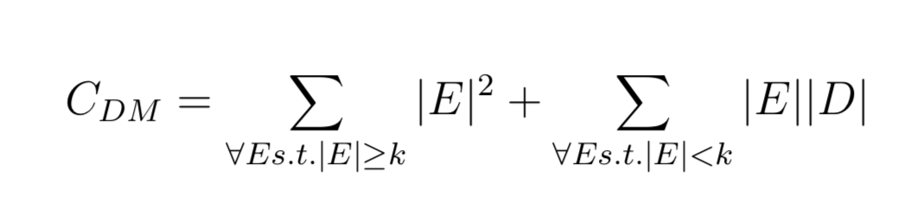
Optimization-based approaches
Optimal anonymization determined by a cost metric
e.g., Discernability metric: assigns a penalty to each tuple based on how many tuples in the transformed dataset are indistinguishable from it. If an unsuppressed tuple falls into an induced equivalence class of size j, then that tuple is assigned a penalty of j. If a tuple is suppressed, then it is assigned a penalty of |D|, the size of the input dataset. Below, E is equivalence classes of tuples in D induced by the anonymization.
Bayardo, 2005

Slide 21
Thinking about limitations

Slide 22
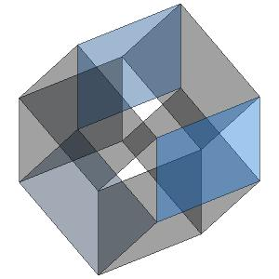
Curse of Dimensionality
Generalization fundamentally relies on spatial locality
Each record must have k close neighbors
Real-world datasets are very sparse
Many attributes (dimensions)
Netflix Prize dataset: 17,000 dimensions
Amazon customer records: several million dimensions
“Nearest neighbor” is very far
Projection to low dimensions loses all info ⇒ k-anonymized datasets are useless
[Aggarwal VLDB ‘05]

Slide 23
Disclosure Control
Membership disclosure: Attacker cannot tell that a given person in the dataset
Sensitive attribute disclosure: Attacker cannot tell that a given person has a certain sensitive attribute
Identity disclosure: Attacker cannot tell which record corresponds to a given person
This interpretation is correct, assuming the attacker does not know anything other than quasi-identifiers

Slide 24
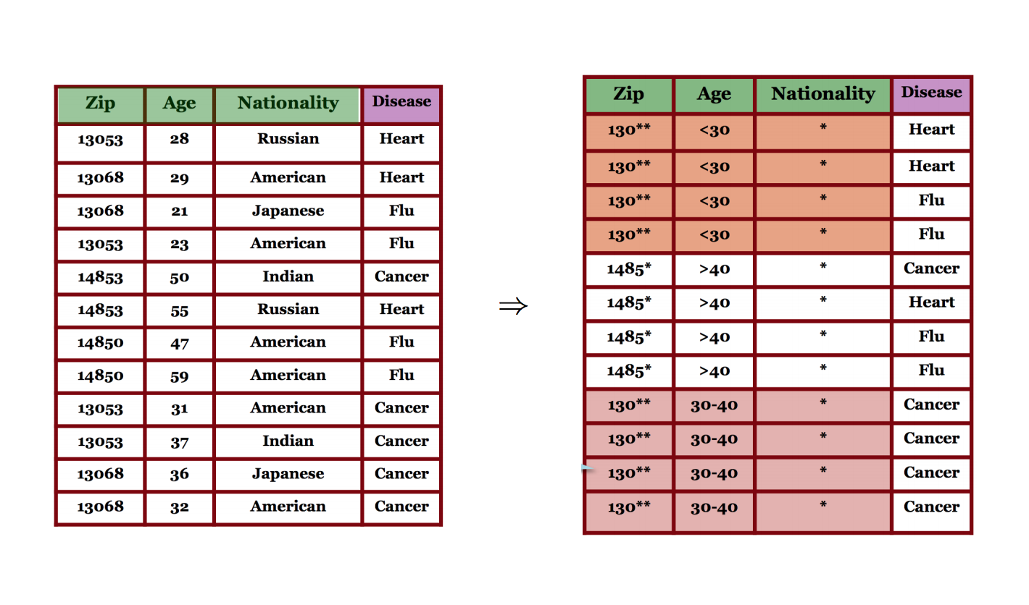
A k-anonymized dataset

Slide 25
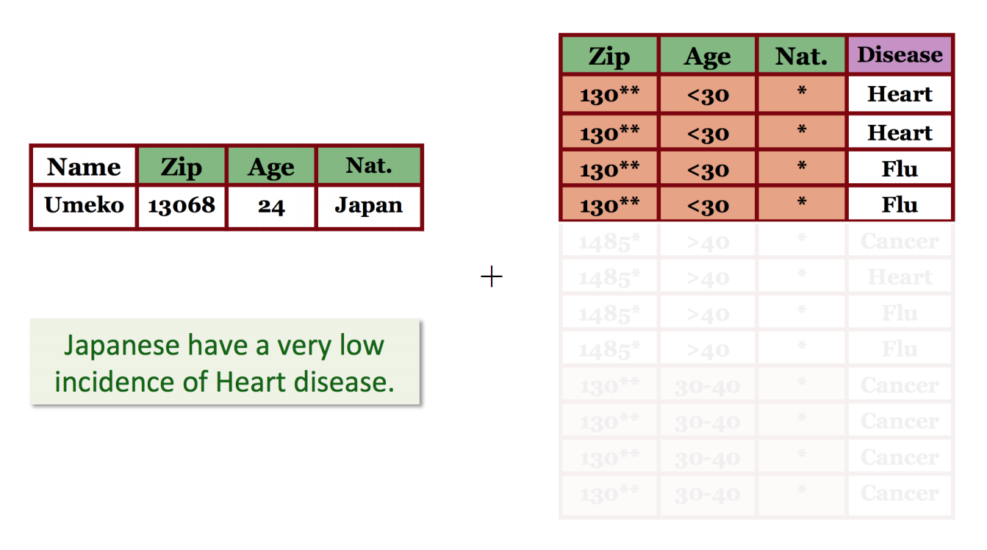
Background attack

Slide 26
Membership Disclosure
Consider some quasi-identifier that is (relatively) unique in the population
But generalizing/suppressing quasi-identifiers in the dataset does not affect their distribution in the population (obviously)!
Suppose anonymized dataset contains 10 records with a certain quasi-identifier …
… and there are 10 people in the population who match this quasi-identifier
k-anonymity may not hide whether a given person is in the dataset

Slide 27
Sensitive Attribute Disclosure
Intuitive reasoning:
k-anonymity prevents attacker from telling which record corresponds to which person
Therefore, attacker cannot tell that a certain person has a particular value of a sensitive attribute
This reasoning is fallacious!

Slide 28
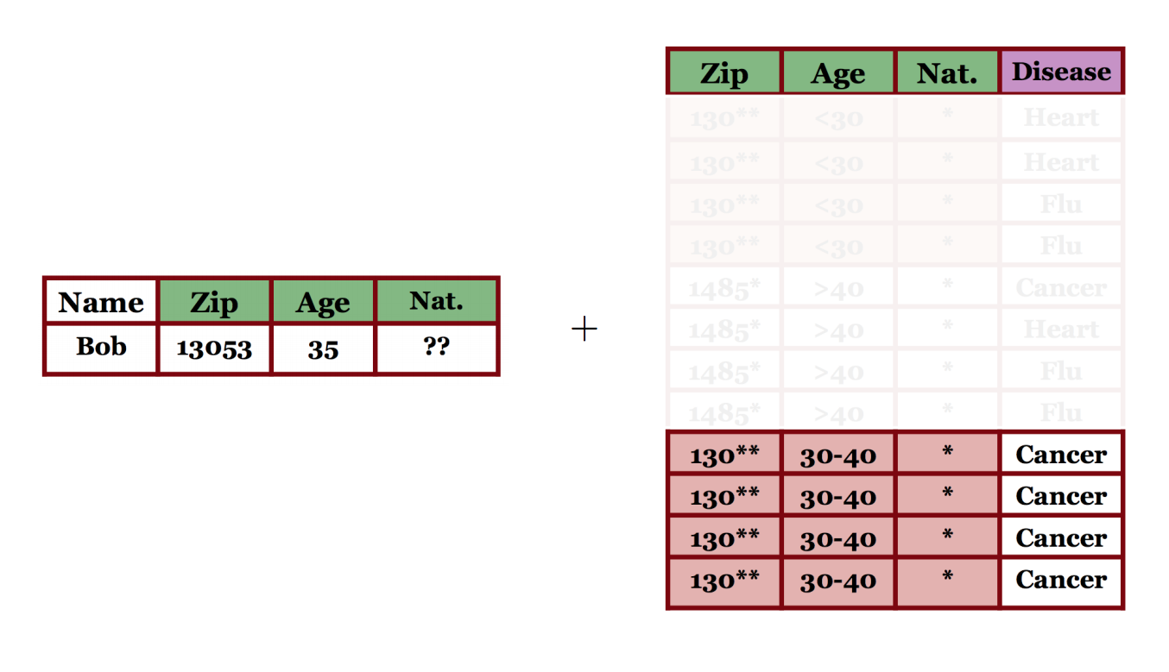
Homogeneity attack

Slide 29
Remediating limitations of k-anonymity
l-diversity and t-closeness

Slide 30
Homogeneity attack – another example
Caucas | 78712 | Flu
Asian | 78705 | Shingles
Caucas | 78754 | Flu
Asian | 78705 | Acne
AfrAm | 78705 | Acne
Caucas | 78705 | Flu
Caucas | 787XX | Flu
Asian/AfrAm | 78705 | Shingles
Caucas | 787XX | Flu
Asian/AfrAm | 78705 | Acne
Asian/AfrAm | 78705 | Acne
Caucas | 787XX | Flu
This is 3-anonymous, right?

Slide 31
Caucas | 787XX | Flu
Asian/AfrAm | 78705 | Shingles
Caucas | 787XX | Flu
Asian/AfrAm | 78705 | Acne
Asian/AfrAm | 78705 | Acne
Caucas | 787XX | Flu
… | … | …
Rusty Shackleford | Caucas | 78705
… | … | …
Problem: sensitive attributes are not “diverse”
within each quasi-identifier group

Slide 32
Homogeneity attack
via correspondence to suppressed variables
Microdata
Generalized table
QID |  |  | SA
Zipcode | Age | Sex | Disease
47677 | 29 | F | Ovarian Cancer
47602 | 22 | F | Ovarian Cancer
47678 | 27 | M | Prostate Cancer
47905 | 43 | M | Flu
47909 | 52 | F | Heart Disease
47906 | 47 | M | Heart Disease
QID |  |  | SA
Zipcode | Age | Sex | Disease
476** 476** 476** | 2* 2* 2* | * * * | Ovarian Cancer Ovarian Cancer Prostate Cancer
4790* 4790* 4790* | [43,52] [43,52] [43,52] | * * * | Flu Heart Disease Heart Disease
!!
Released table is 3-anonymous
If the adversary knows Alice’s quasi-identifier (47677, 29, F), he still does not know which of the first 3 records corresponds to Alice’s record

Slide 33
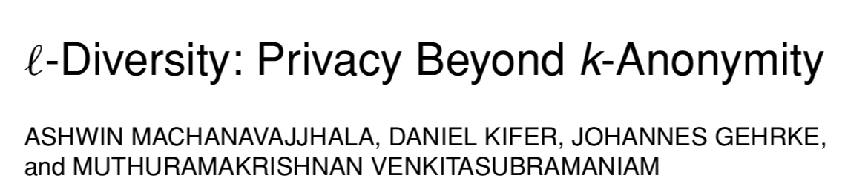
l-diversity
Caucas | 787XX | Flu
Caucas | 787XX | Shingles
Caucas | 787XX | Acne
Caucas | 787XX | Flu
Caucas | 787XX | Acne
Caucas | 787XX | Flu
Asian/AfrAm | 78XXX | Flu
Asian/AfrAm | 78XXX | Flu
Asian/AfrAm | 78XXX | Acne
Asian/AfrAm | 78XXX | Shingles
Asian/AfrAm | 78XXX | Acne
Asian/AfrAm | 78XXX | Flu
[Machanavajjhala et al., ICDE ‘06]
Sensitive attributes must be
“diverse” within each
quasi-identifier equivalence class

Slide 34
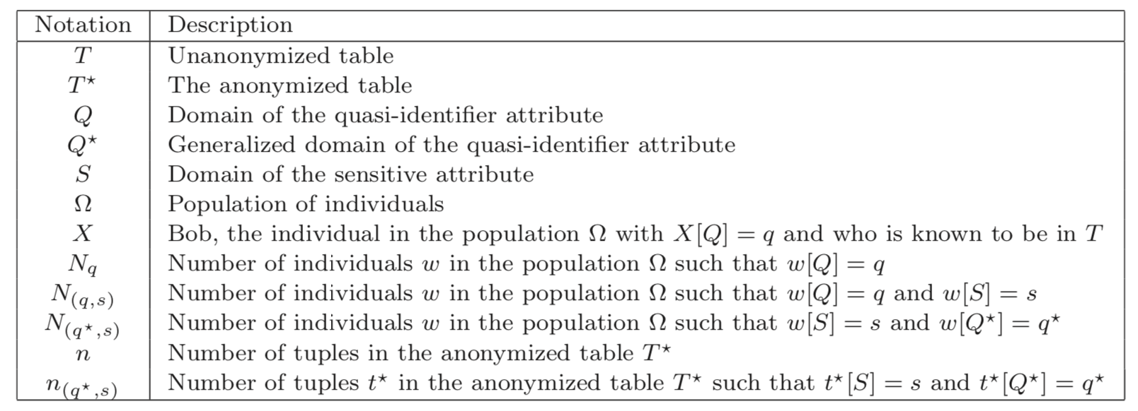
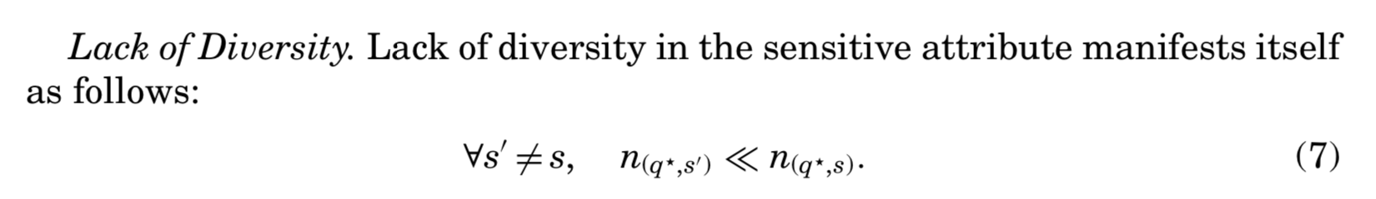
[Machanavajjhala et al., ICDE ‘06]

Slide 35
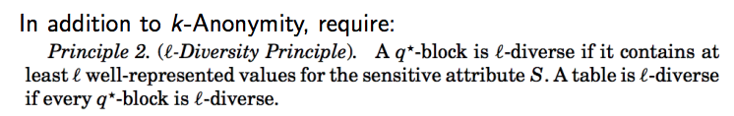
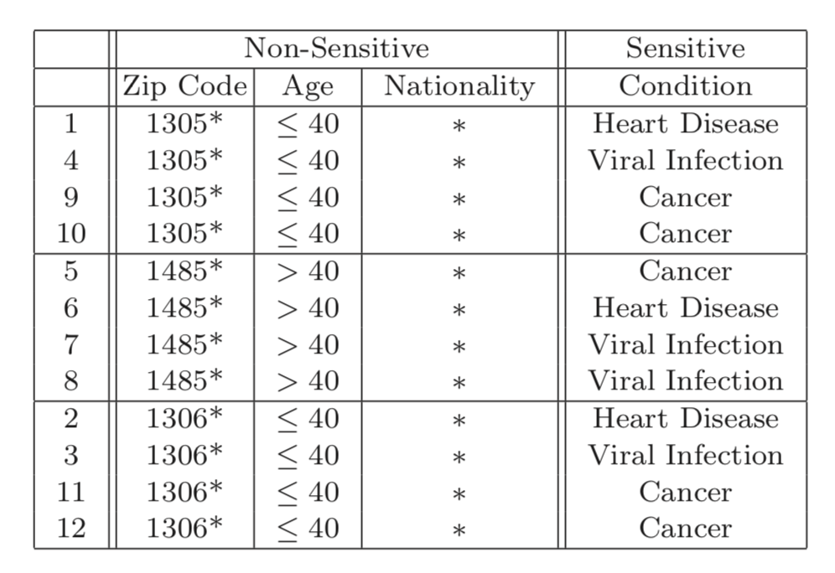
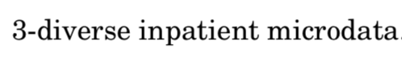

Slide 36
Distinct l-diversity
Each equivalence class has at least l well-represented sensitive values
Doesn’t prevent probabilistic inference attacks
8 records have HIV
10 records
2 records have other values
This satisfies 3-diversity, but the attacker can still affirm that the target person’s disease is HIV with accuracy of 80%

Slide 37
Other versions of l-diversity
Probabilistic l-diversity
The frequency of the most frequent value in an equivalence class is bounded by 1/l
Entropy l-diversity
The entropy of the distribution of sensitive values in each equivalence class is at least log(l)
Recursive (c,l)-diversity
r₁< c(r_{l}+r_{l+1}+…+r_{m}) where r_{i} is the frequency of the i^{th} most frequent value
Intuition: the most frequent value does not appear too frequently
[Machanavajjhala et al. ICDE ‘06]

Slide 38
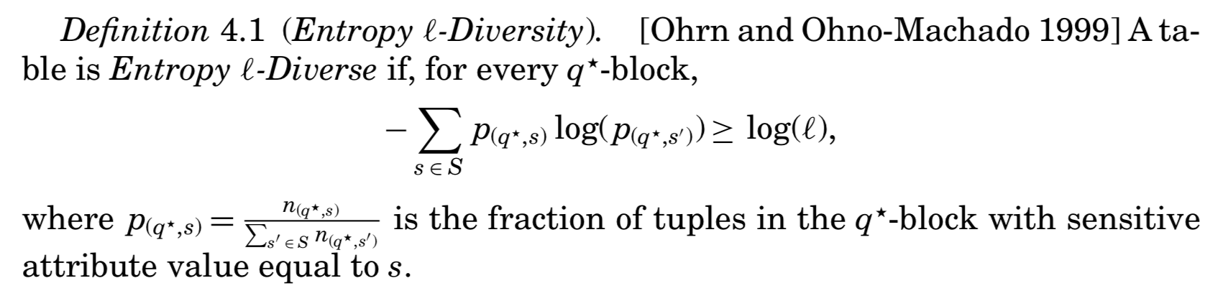
Entropy l-diversity → captures the notion of well-represented groups
Each equivalence class not only must have enough different sensitive values, but also the different sensitive values must be distributed evenly enough.
As a consequence of this condition, every q*-block has at least l distinct values for the sensitive attribute.
Sometimes this maybe too restrictive. When some values are very common, the entropy of the entire table may be very low.

Slide 39
Let’s go back to this example:
This table is Entropy l-diverse for what value of l?

Slide 40
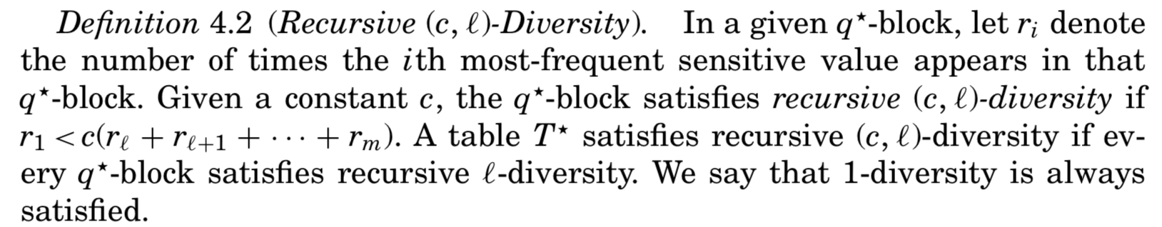
Recursive l-diversity → captures the role of background knowledge
Intuitively, we make sure that the most frequent value does not appear too frequently, and the less frequent values do not appear too rarely.
Constant
r_{i} denote the number of times the ith most frequent sensitive value appears

Slide 41
Let’s go back to this example:
To satisfy recursive (c,2) diversity, we would require:
r₁< c(r₂+ r₃)
r₃=1
r₂=1
r₁=2
To satisfy recursive (c,3) diversity, we would require:
r₁< c(r₃)

Slide 42
Limitations of l-Diversity
Limitation 1: l-diversity may be difficult and unnecessary to achieve
Consider a table of 10,000 records containing patient information on sensitive attribute HIV+/HIV-. Consider that 99% of the records are HIV- and 1% are HIV+.
(unnecessary) One would not mind being known to be tested negative. Equivalence classes containing only HIV- records are probably OK.
(difficult) To have distinct 2-diversity, there can be at most 10,000*1%=100 equivalence classes → information loss would likely be large in order to achieve that generality.
The two different values of the sensitive attribute have very different degrees of sensitivity!
[Li et al. ICDE ‘07]

Slide 43
l-diversity: not always necessary
Original dataset
Anonymization
… | HIV-
… | HIV-
… | HIV-
… | HIV-
… | HIV-
… | HIV+
… | HIV-
… | HIV-
… | HIV-
… | HIV-
… | HIV-
… | HIV-
Q1 | HIV-
Q1 | HIV-
Q1 | HIV-
Q1 | HIV+
Q1 | HIV-
Q1 | HIV-
Q2 | HIV-
Q2 | HIV-
Q2 | HIV-
Q2 | HIV-
Q2 | HIV-
Q2 | Flu
99% HIV- ⇒ quasi-identifier group is not “diverse”
…yet anonymized database does not leak anything
99% have HIV-

Slide 44
Skewness Attack
Limitation 2: l-diversity may be insufficient to prevent attribute disclosure
Consider the same table of 10,000 records containing patient information on sensitive attribute HIV+/HIV-.
Consider one equivalence class in the generalized table has an equal number of positive records and negative records. It satisfies distinct 2-diversity, entropy 2-diversity and any recursive (c,2)-diversity requirement that can be imposed.
However, it presents a very serious privacy risk– anyone in the class would be considered to have 50% possibility of being positive, as compared to 1% of the overall population.

Slide 45
l-diversity: not always sufficient
Original dataset
Anonymization
l-diversity does not differentiate between:
Equivalence class 1: 49 HIV+ and 1 HIV-
Equivalence class 2: 1 HIV+ and 49 HIV-
… | HIV-
… | HIV-
… | HIV-
… | HIV-
… | HIV-
… | HIV+
… | HIV-
… | HIV-
… | HIV-
… | HIV-
… | HIV-
… | HIV-
Q1 | HIV+
Q1 | HIV-
Q1 | HIV+
Q1 | HIV-
Q1 | HIV+
Q1 | HIV-
Q2 | HIV-
Q2 | HIV-
Q2 | HIV-
Q2 | HIV-
Q2 | HIV-
Q2 | HIV-
l-diversity does not consider the overall distribution of sensitive values
50% HIV- ⇒ quasi-identifier group is “diverse”
This leaks a ton of information
→ If we know you are in this quasi-id equivalence class, we know you have 50% of being HIV+.
99% have HIV-

Slide 46
Similarity Attack
A 3-diverse patient table
Zipcode | Age | Salary | Disease
476** | 2* | 20K | Gastric Ulcer
476** | 2* | 30K | Gastritis
476** | 2* | 40K | Stomach Cancer
4790* | ≥40 | 50K | Gastritis
4790* | ≥40 | 100K | Flu
4790* | ≥40 | 70K | Bronchitis
476** | 3* | 60K | Bronchitis
476** | 3* | 80K | Pneumonia
476** | 3* | 90K | Stomach Cancer
Bob
Zip | Age
47678 | 27
Conclusion
Bob’s salary is in [20k,40k]
Bob has some stomach-related disease
l-diversity does not consider semantics of sensitive values!

Slide 47
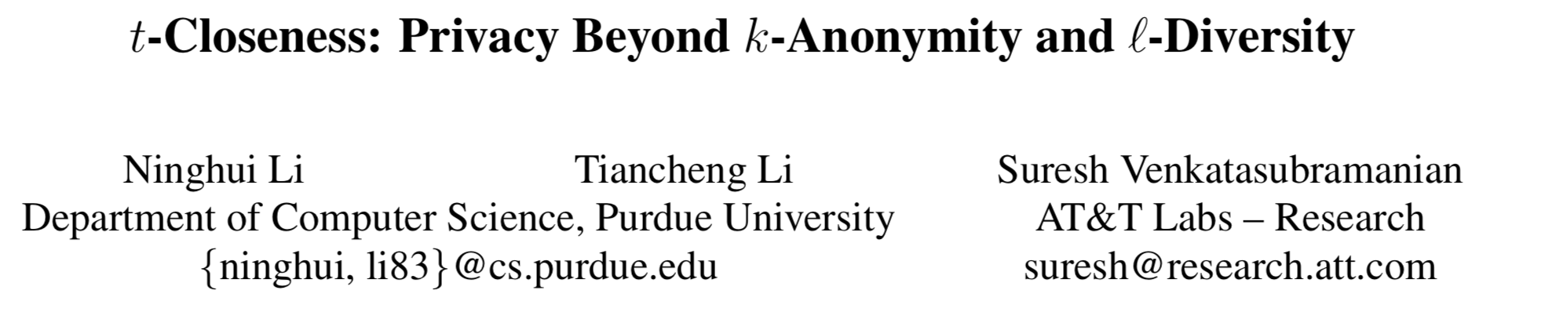
T-Closeness
Caucas | 787XX | Flu
Caucas | 787XX | Shingles
Caucas | 787XX | Acne
Caucas | 787XX | Flu
Caucas | 787XX | Acne
Caucas | 787XX | Flu
Asian/AfrAm | 78XXX | Flu
Asian/AfrAm | 78XXX | Flu
Asian/AfrAm | 78XXX | Acne
Asian/AfrAm | 78XXX | Shingles
Asian/AfrAm | 78XXX | Acne
Asian/AfrAm | 78XXX | Flu
[Li et al. ICDE ‘07]
Distribution of sensitive
attributes within each
quasi-identifier group should
be “close” to their distribution
in the entire original database
Notes:
Trick question: Why publish
quasi-identifiers at all??

Slide 48
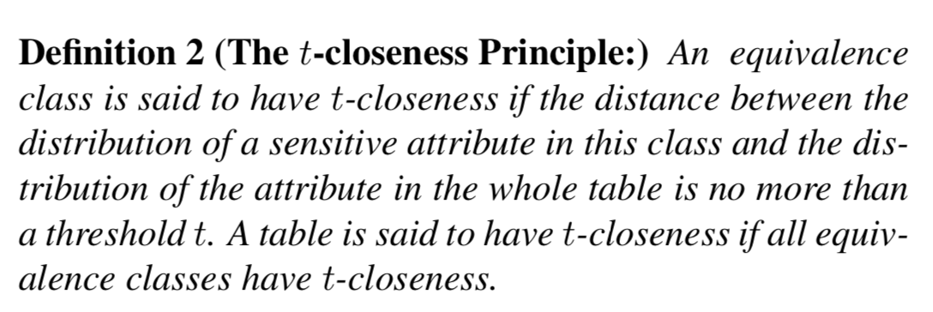
Need a measurement for distance between two probability distributions. Variational distance and Kullback-Leibler (KL) distance are well-known options.
But they don’t account for semantic distance. E.g., salary of $40k vs. $50 are much “closer” than salary of $40k vs. $100k. It’s not binary match/non-match.
We can create a “ground distance” between attribute values in some metric space, and then we would like a measurement for distance between two probability distributions that also depends on ground distances amongst these values.
Authors suggest the Earth Mover’s distance (EMD) based on amount of work needed to transform one distribution to another by moving distribution mass.
See [Li et al. ICDE ‘07] for more details on calculating EMD…
Notes:
Trick question: Why publish
quasi-identifiers at all??

Slide 49
k-anonymous, “t-close” Dataset
Caucas | 787XX | HIV+ | Flu
Asian/AfrAm | 787XX | HIV- | Flu
Asian/AfrAm | 787XX | HIV+ | Shingles
Caucas | 787XX | HIV- | Acne
Caucas | 787XX | HIV- | Shingles
Caucas | 787XX | HIV- | Acne
This is k-anonymous,
l-diverse and t-close…
…so secure, right?

Slide 50
What Does Attacker Know?
Bob is Caucasian and I heard he was admitted to the hospital with the flu…
Caucas | 787XX | HIV+ | Flu
Asian/AfrAm | 787XX | HIV- | Flu
Asian/AfrAm | 787XX | HIV+ | Shingles
Caucas | 787XX | HIV- | Acne
Caucas | 787XX | HIV- | Shingles
Caucas | 787XX | HIV- | Acne
Notes:
Sensitive attribute as background knowledge or QI

Slide 51
What Does Attacker Know?
Bob is Caucasian and
I heard he was admitted to hospital
…
And I know three other Caucasians were admitted to hospital with acne or shingles …
Caucas | 787XX | HIV+ | Flu
Asian/AfrAm | 787XX | HIV- | Flu
Asian/AfrAm | 787XX | HIV+ | Shingles
Caucas | 787XX | HIV- | Acne
Caucas | 787XX | HIV- | Shingles
Caucas | 787XX | HIV- | Acne
Notes:
Instance knowledge

Slide 52
Some Takeaways
Security/privacy is always an arms race
Security/privacy is challenging, particularly if you are the defender
Adopt the adversarial mindset
......it would be great to have formal guarantees of privacy regardless of the attacker’s background knowledge….
Notes:
but behave like a gentleman
Think about how things may fail instead of how it may work

Slide 53
Break (& post to discussion)

Slide 54
Presentation

Slide 55
Hands-on activity!
Head to https://mybinder.org
From there, launch https://github.com/SarahRajtmajer/DataPrivacy_Spring2022
From there,
Open “k-Anonymity.ipynb”

Slide 56
Homework 2 is now posted, due Feb. 28
Thank you!

